Slide 1

AN INNOVATIVE WEARABLE HEALTH MONITORING SENSORS USING IOT
Department of Electronics and Communication Engineering
School of Electrical and Electronics
DONE BY
R.SAKTHI AISHWARYA(39130389)
Batch no - 190
INTERNAL GUIDE
DR.I.REXILINE SHEEBA

Slide 2
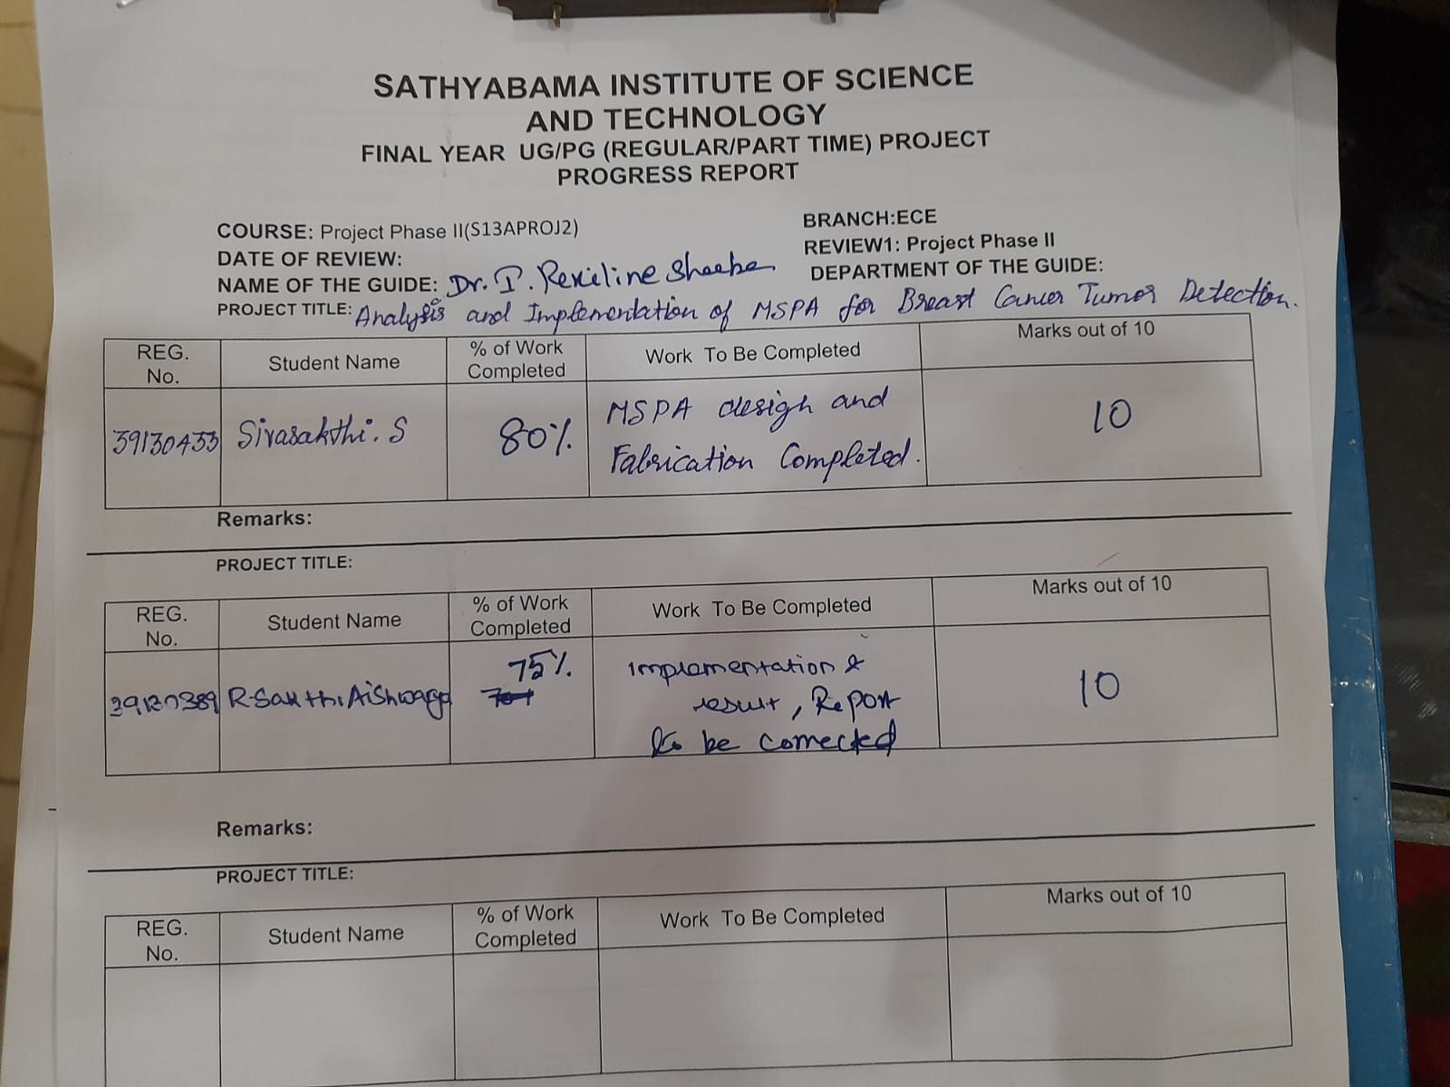
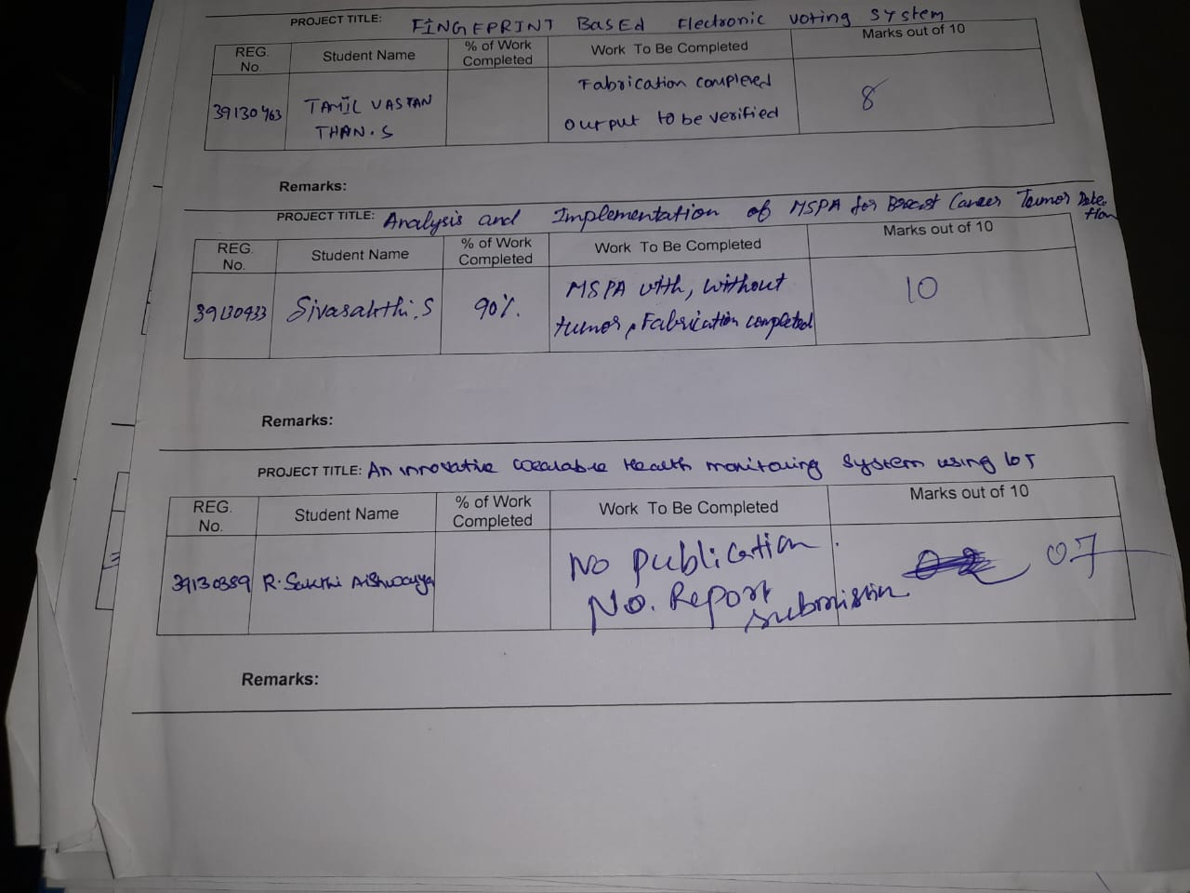

Slide 3
OBJECTIVES
The main objective of the wearable health monitoring system: To make an automated system that will help to monitor host remotely is our primary objective.
To create an alarm or reaction system which will react whenever there is an alarming situation. To provide a way to remotely control the temperature, pulse, blood pressure via ESP32.
To contribute to the field of IOT to pave the way for a future project in technological development.

Slide 4
INTRODUCTION
Internet of things is a network of interconnected devices that are equipped with software, sensors, network connectivity and electronic devices that allow them to exchange and collect data, allowing them to be more responsive.
With the growth of IOT, the healthcare industry has made a huge quantitative leap.
People nowadays suffer from wide range of ailments and health issues, including high blood pressure, high rate IOT heart beat which are commonly seen in elderly people.
So, a continuous monitoring device is required to ensure a proper medical care.
This project discusses the advantages of utilizing an ESP32-based system for monitoring the health of a patient.

Slide 5
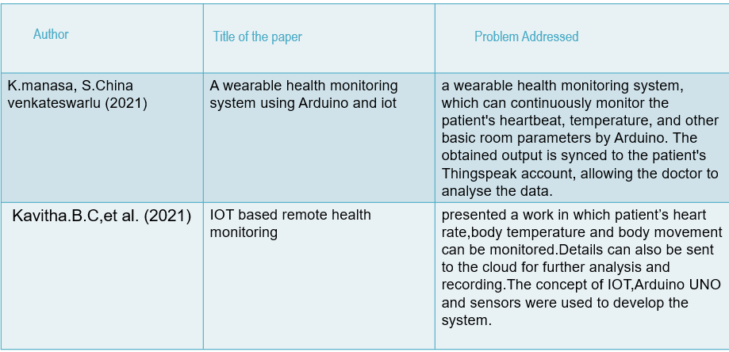
LITERATURE SURVEY

Slide 6
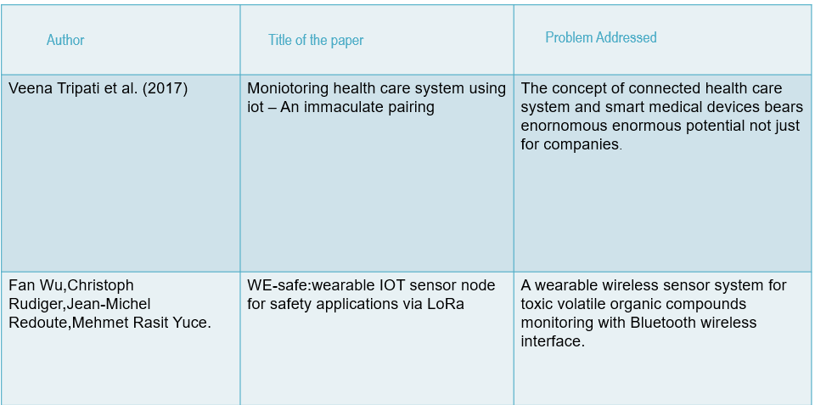
LITERATURE SURVEY

Slide 7
EXISTING METHODOLOGY
The existing system related with health monitoring includes: Diagnosing with help of a doctor ; Conventional devices that can only measure a particular parameter ;Devices that have to be connected invasive to get measurements ; No automated system exists; Smart watches are expensive and not specially for health care.
In existing system, patient needs to get hospitalized for regular monitoring of the patient.
It is not possible once he/she is discharged from the hospital. This system cannot be used at home.
The existing systems are measuring the health parameters of the patient and send it through zig bee, Bluetooth protocol etc., These are used for only short range communication to transfer the data.
Not all the time the doctor can fetch these details.

Slide 8
PROPOSED METHODOLOGY
In the proposed health monitoring system 24 x 7 human health monitoring is designed.
In this system, the ESP32 board is used for collecting and processing all data.
Wireless devices have invaded the medical area with a wide range of capabilities.
Monitor the patient details in a periodic interval is overhead using existing technologies.
To overcome this have changed recent wireless sensor technologies.
Added advanced sensors like pulse oximeter for measuring blood pressure. Different Sensors used for, measuring different parameters.

Slide 9
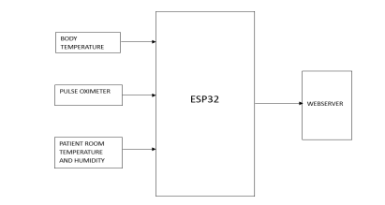
BLOCK DIAGRAM OF PROPOSED METHOD

Slide 10
AIM
The aim of the system which is preferred to develop would not only help in monitoring the health of the patient when is in bed but also when he is out of bed.
The main idea of the system is to transmit the information through the webpage to continuous monitoring of the patient over internet.
Such a system would continually detect the important body parameters like temperature, pulse rate and would compare it against predetermined range set and if these values cross the specific limit, it would immediately alert the doctor.
In this system microcontroller is used to transmit the data.

Slide 11
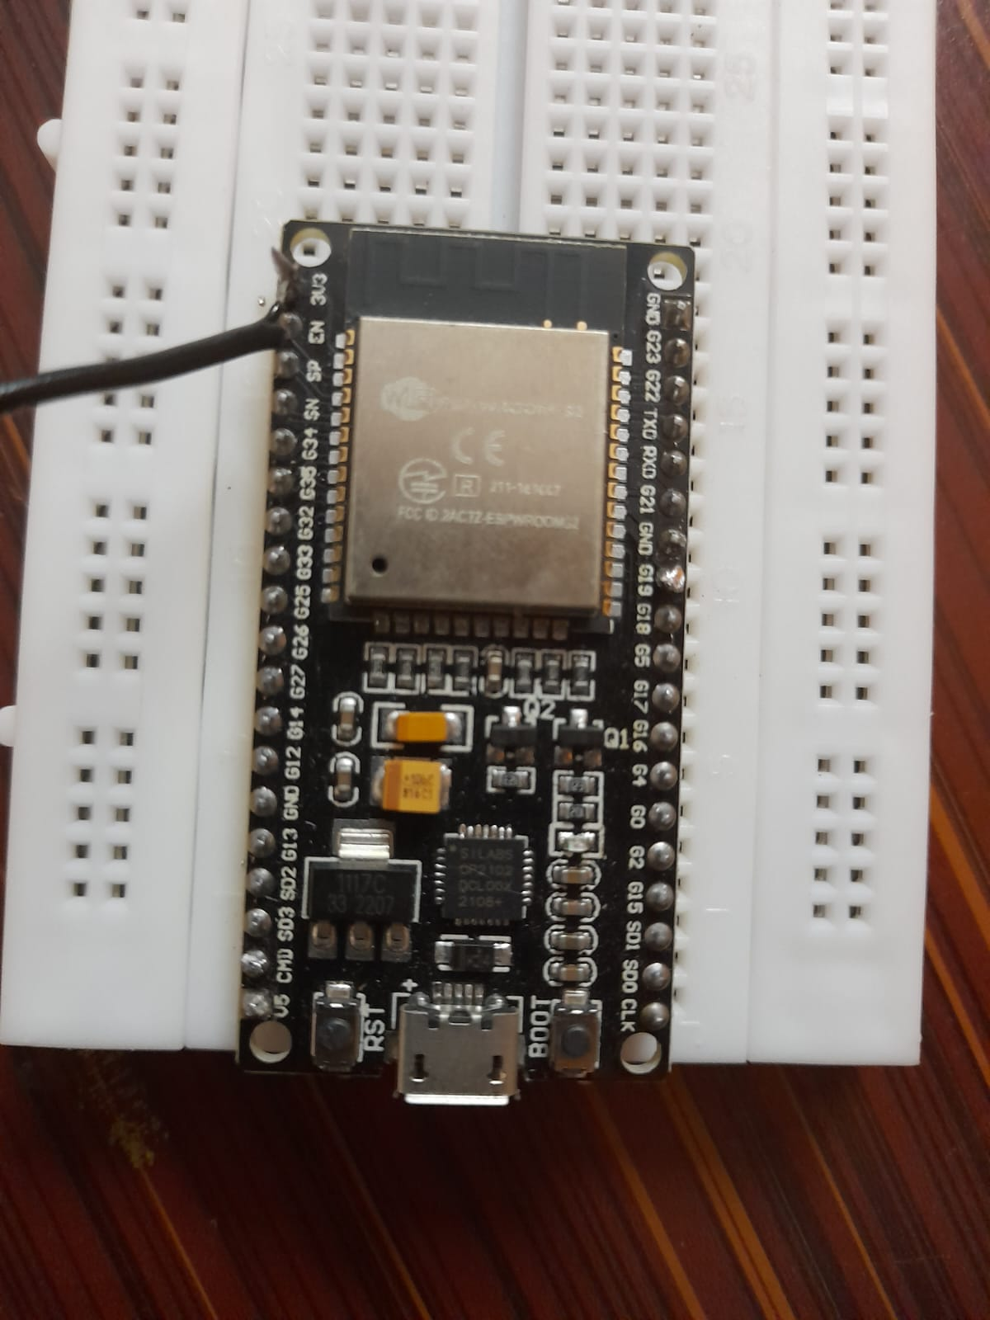
COMPONENTS REQUIRED
ESP32
ESP32 is the SoC (System on Chip) microcontroller.
ESP32 is highly-integrated with in-built antenna switches, power amplifier, low-noise receive amplifier, filters, and power management modules.
ESP32 adds priceless functionality and versatility to your applications with minimal Printed Circuit Board (PCB) requirements

Slide 12
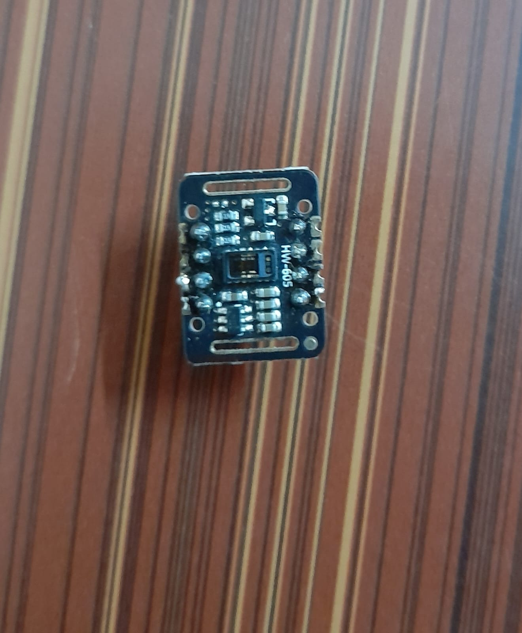
PULSE OXIMETER
The MAX30102 is an integrated pulse oximetry and heart-rate monitor module.
It includes internal LEDs, photodetectors, optical elements, and low-noise electronics with ambient light rejection.
The MAX30102 provides a complete system solution to ease the design-in process for mobile and wearable devices.
The MAX30102 operates on a single 1.8V power supply and a separate 3.3V power supply for the internal LEDs.

Slide 13
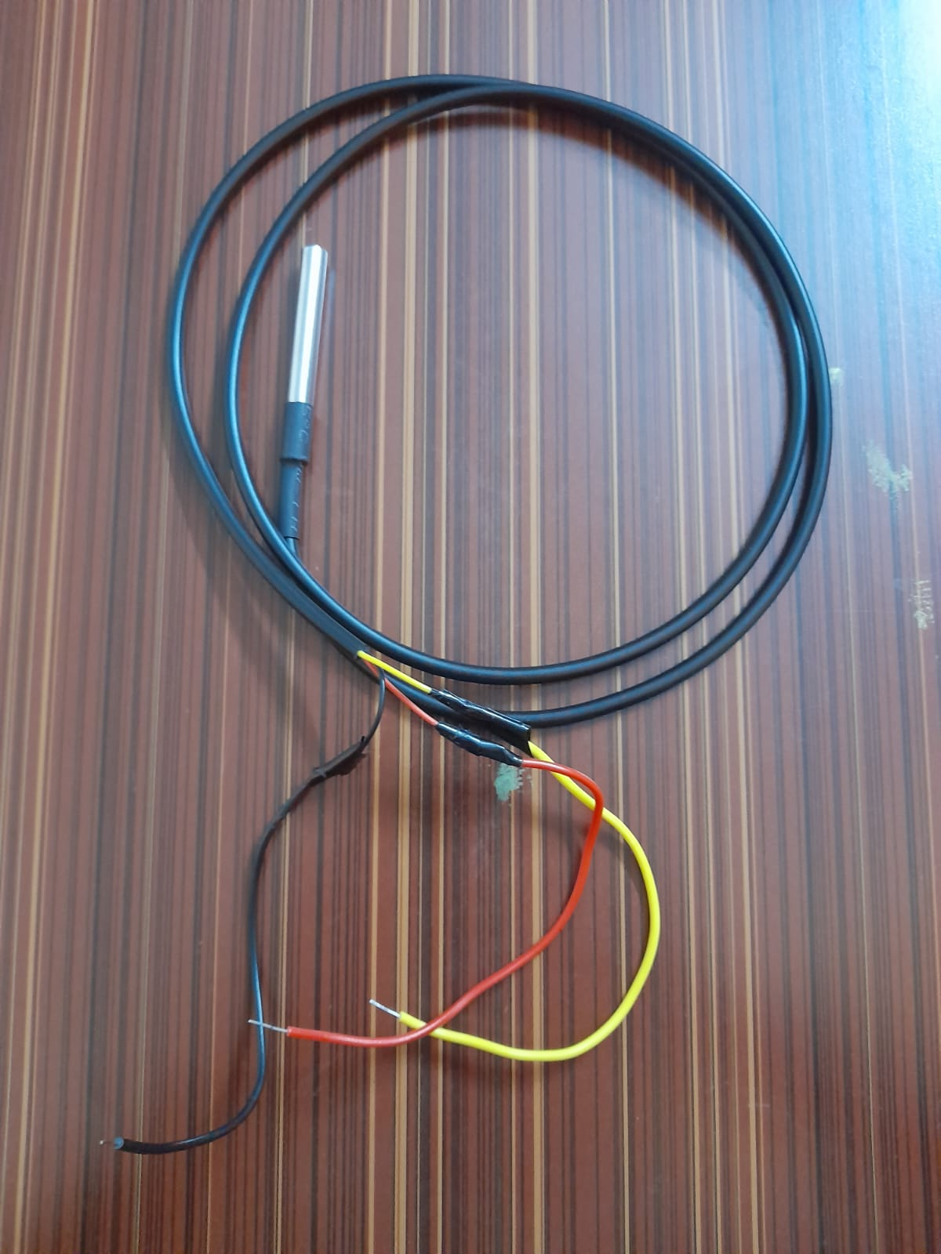
TEMPERATURE SENSOR
The DS18B20 digital thermometer provides 9-bit to 12-bit Celsius temperature measurements and has an alarm function with nonvolatile user-programmable upper and lower trigger points.
The DS18B20 communicates over a 1-Wire bus that by definition requires only one data line (and ground) for communication with a central microprocessor.
Each DS18B20 has a unique 64-bit serial code, which allows multiple DS18B20s to function on the same 1-Wire bus.

Slide 14
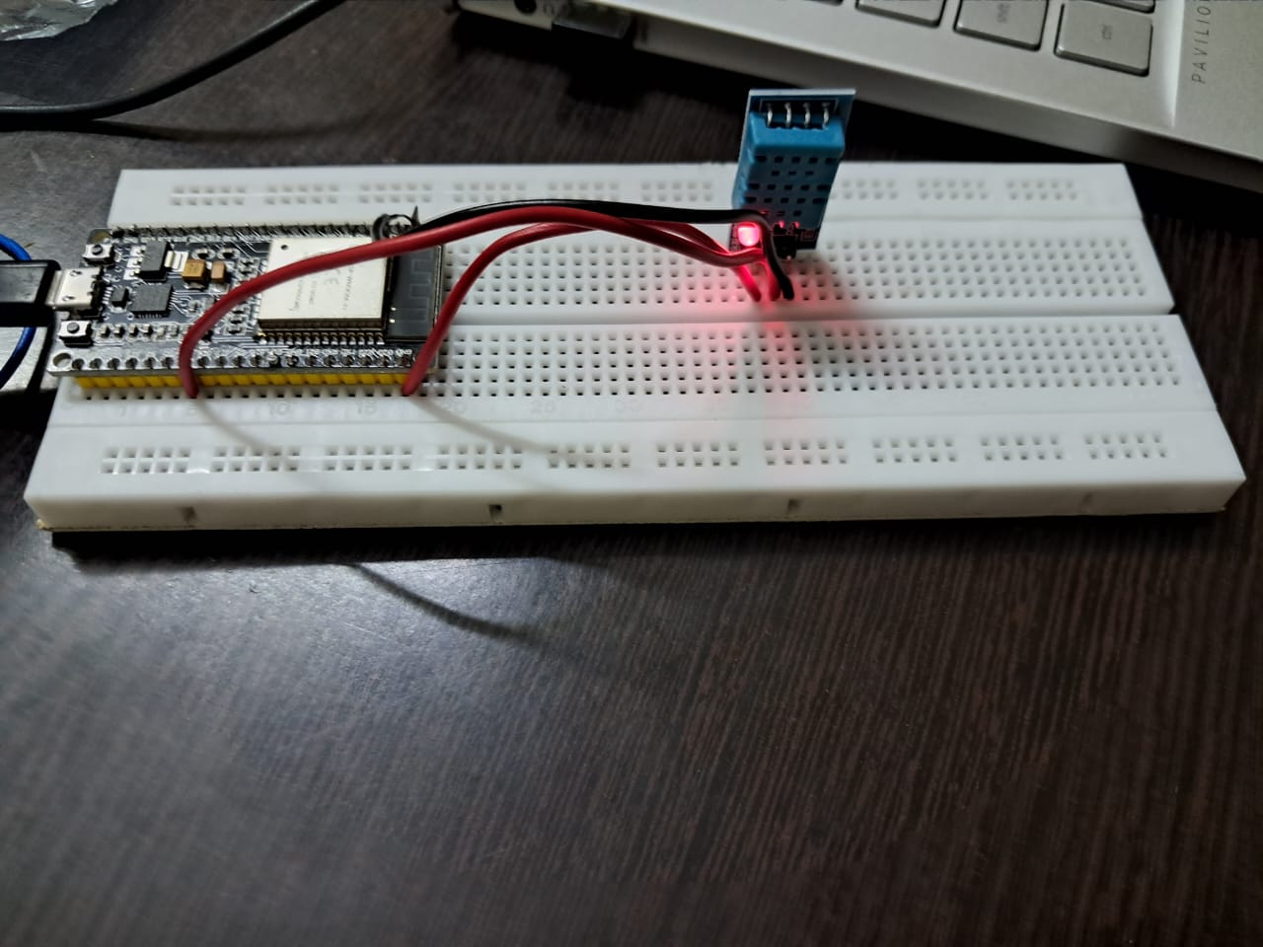
PATIENT ROOM TEMPERATURE AND HUMIDITY
DHT11 Temperature & Humidity Sensor features a temperature & humidity sensor complex with a calibrated digital signal output.
By using the exclusive digital signal- acquisition technique and temperature & humidity sensing technology, it ensures high reliability and excellent long-term stability.
Each DHT11 element is strictly calibrated in the laboratory that is extremely accurate on humidity calibration.

Slide 15
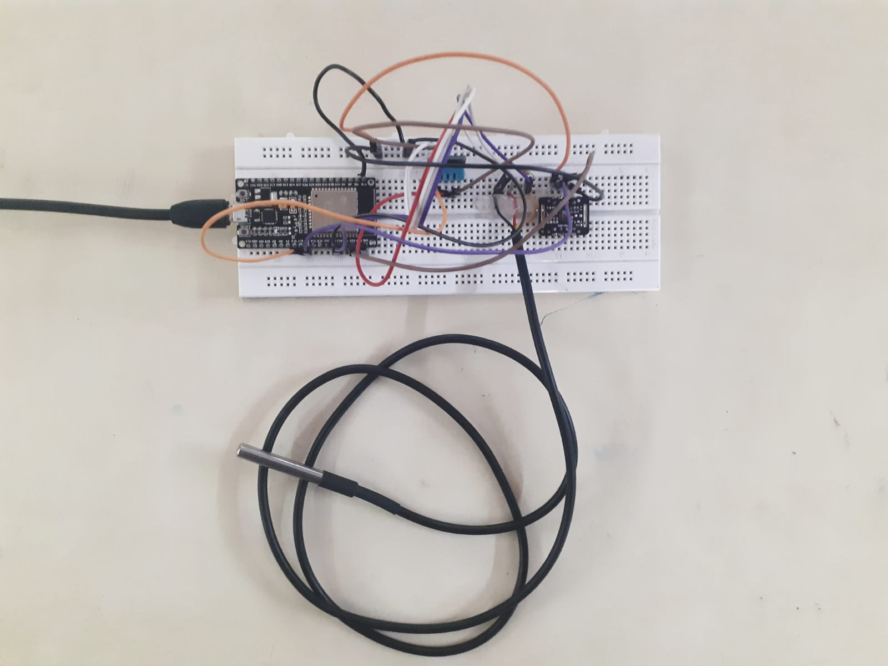
PROJECT

Slide 16
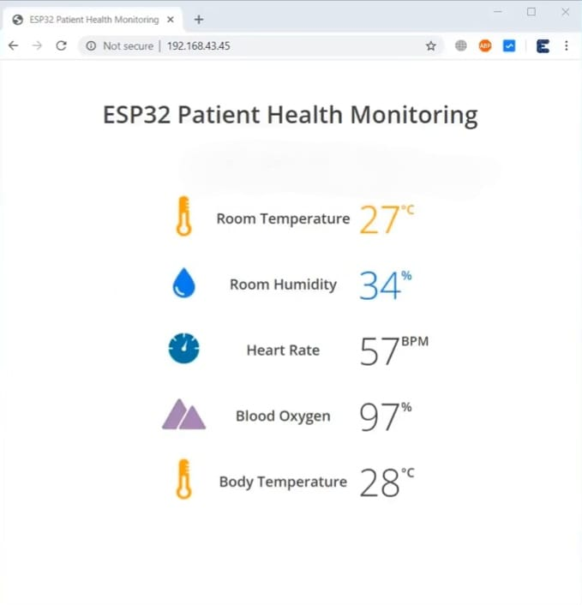
RESULT

Slide 17
ADVANTAGES
• Reduce risk of disease transmission.
• Faster access to better patient data.
• Improved patient outcomes
• Cost savings
• It is easy for patients and medical professionals to use the system.

Slide 18
CONCLUSION:
The sensors used in this monitoring system were developed and the patient’s health was monitored based on IoT, which is an alternative of the existing one.
This health monitoring system can improve patients’ health and helpful for fast recovering of a patient.
It us an efficient system when compared with others existing technology.
A wearable health monitoring system that guarantees a constant monitoring of various health parameters and prevents the patients from frequent visit to the hospital Our suggested system is comprised of low-cost medical devices linked towards a low-cost health platform that sends emergency notifications to medical practitioners.

Slide 19
REFERENCE
[1] K. Jhansi Priya, K.Harish Yadav, K.Jyothsna “ A Portable Wearable Tele Ecg Monitoring System”, International Journal Of Engineering Applied Sciences And Technology, ISSN No. 2455-2143, pp. 683-690.
[2] Shivkumar Dharmoji, Akshata Anigolkar, Prof. Shraddha M “IOT based Patient Health Monitoring using ESP8266”, International Research Journal of Engineering and Technology (IRJET)
[3] Md.Raseduzzaman Ruman; Amit Barua; Waladur Rahman; Khan Roushan Jahan; Md.Jamil Roni; Md.Foyjur Rahman “ IOT based Emergency Health Monitoring system”, International Conference on Industry 4.0 Technology (I4Tech).
[4] G.Sharanya, C.SaiAbhishek, K.Manikanth Reddy “Health Monitoring Device”, 2nd International Conference on Communication and Electronics Systems (ICCES).
[5]Sneha Sravanthi D, Srivalli.M, Srilakshmi.S, Sneha Mol. P .S “Personal Health Monitoring System using Arduino and Android”, International Journal of Engineering Research & Technology (IJERT).

Slide 20
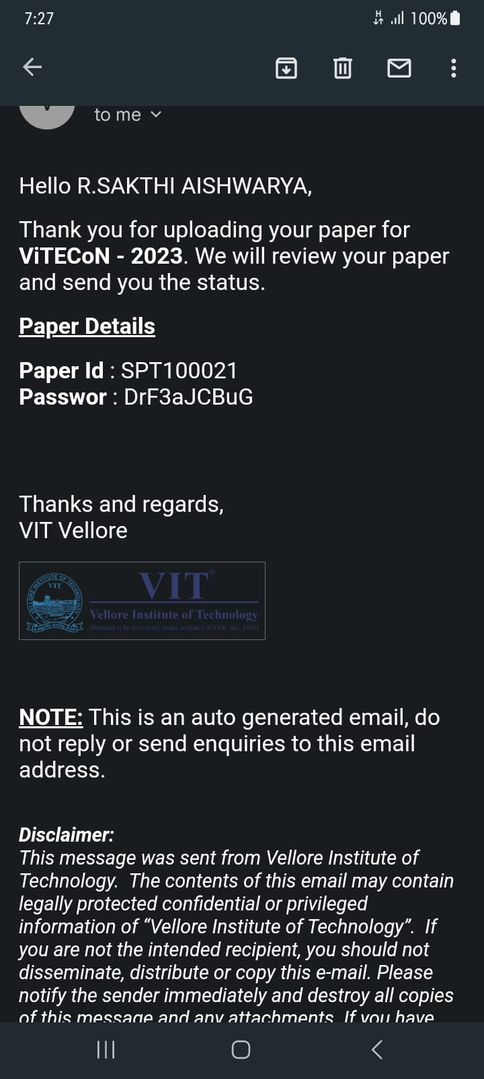
APPLIED IN CONFERENCE

